Slide 1
Writing Business Messages
Your messages must be livelier, easier to read, more concise and more interesting than ever before as audience is exposed to an increasing number of business messages
To compete for attention, business messages must be purposeful, audience-centered, and concise

Slide 2
Systematic Writing Process
Three simple steps-
  Planning
  Writing
  Completing
STEP 1:
Planning-
      Define your purpose
      Analyze audience
      Select appropriate channel
      Establish a good relationship with your audience

Slide 3
STEP 1: Planning (Contd.)
Define your purpose:
  To inform/to persuade/to collaborate with your audience
  To inform- you need little interaction; you are in control
  To persuade-you require moderate participation from audience; you need to retain moderate control over message
  To collaborate- Maximum participation required and control of the message is minimal as you must adjust to new input and unexpected reactions
  Consider : If the purpose is realistic, timing is right, you are the right person to deliver the message

Slide 4
STEP 1: Planning (Contd.)
b. Analyze audience:
      Identify the primary audience
      Size of the audience
      Composition of the audience
      Gauge audience’s level of understanding
      Project audience’s expectations and preferences
      Estimate probable reaction

Slide 5
STEP 1: Planning (Contd.)
c. Select appropriate channel and media
- Prior to writing , make sure your channel and medium match your purpose and your audience
- Time and cost affect medium selection
- Feedback required or not
- Addressed or unaddressed
- Your intentions heavily influence your choice of media
Use oral channels for collaboration

Slide 6
STEP 1: Planning (Contd.)
d. Establish a good relationship with your audience
1. Use “you” attitude
2. Emphasize the positive
3. Establish your credibility
4. Use bias-free language
5. Project the company’s image
6. Be polite

Slide 7
STEP 1: Planning (Contd.)
d. Establish a good relationship Using You Attitude
- YOU attitude is best implemented by expressing your message in terms of audience’s interests, wishes, hopes and needs
- Use YOU and YOURS instead of I, me, mine, we, us, and ours
Instead of this Use this
We offer the suits in three You can select your suit
Colors:…………………………… from three colors:….
We are pleased to announce our new Now you can take a plane
Flight from Dhaka to Khulna from Dhaka to Khulna
To help us process this order, we must So that your order can be filled
Ask for another copy of the requisition promptly, please send another copy
of requisition

Slide 8
STEP 1: Planning (Contd.)
d. Establish a good relationship Using you attitude
BUT avoid using you and yours when doing so –
a) Makes you sound dictatorial : “ you must correct all five copies by noon.” RATHER “all five copies must be corrected by noon.”
b) Make someone else feel guilty: “ The deal was cancelled for you” RATHER “We could not finalize the deal for some reasons”
c) Goes against organizational style or culture

Slide 9
STEP 1: Planning (Contd.)
d. Establish a good relationship Emphasizing the positive
 | Instead of this | Use this
When offering criticism or advice, focus on what the person can do to improve | The problem with this department is its failure to control costs | The performance of this department can be improved by tightening up cost
Show how your audience will be benefited from complying you | We need your contribution to the Boys and Girls Club | You can help a child make friends and build self confidence through your donation to the Boys and Girls Club controls
Explain what you have done, what you can do, and what you will do--- not what you haven’t done, can’t do, or won’t do | We never change damaged products It is impossible to make your order ready today | We are happy to exchange merchandise that is returned to us in good condition Your order will be ready by Tuesday

Slide 10
STEP 1: Planning (Contd.)
d. Establish a good relationship Establishing your credibility
- People are more likely to react positively to your message when they have confidence in you
- Enhance your credibility by
a. Explaining your credentials
b. Providing quality information with evidence
c. Avoid too much modesty or lack of confidence
d. Believing yourself
C. Example (Avoid too much modesty or lack of confidence)
We hope this recommendation will be helpful.
We are glad to make this recommendation.
We trust that you will extend your service contract.
By extending your service contract, you can continue to enjoy top notch performance from your equipment

Slide 11
STEP 1: Planning (Contd.)
d. Establish a good relationship Using bias-free language
Gender bias – man-made/ artificial
Ethnic and racial bias – Mak is a tall asian
Age bias- Makbul, 65, has just joined
Disability bias- Crippled workers create problems
d. Establish a good relationship Being polite
Be gentle and tactful
Example: You have been sitting on my order for two weeks and
we need it now.
We are eager to receive our order. When can we expect
delivery?
I was wondering if my application has been approved.

Slide 12
STEP 1: Planning (Contd.)
d. Establish a good relationship Projecting the company’s image
Subordinate your own style to that of your company

Slide 13
STEP 2: Writing
Four most common mistakes made by communicators:
    Taking too long to get to the point
    Including irrelevant material
    Getting ideas mixed up
    Leaving out necessary information
Organize a message
    Define your main idea- inform/persuade/collaborate
    Limit the scope – Deal with three or four major points(!>4)
    Group your points
    Choose the direct or indirect approach

Slide 14
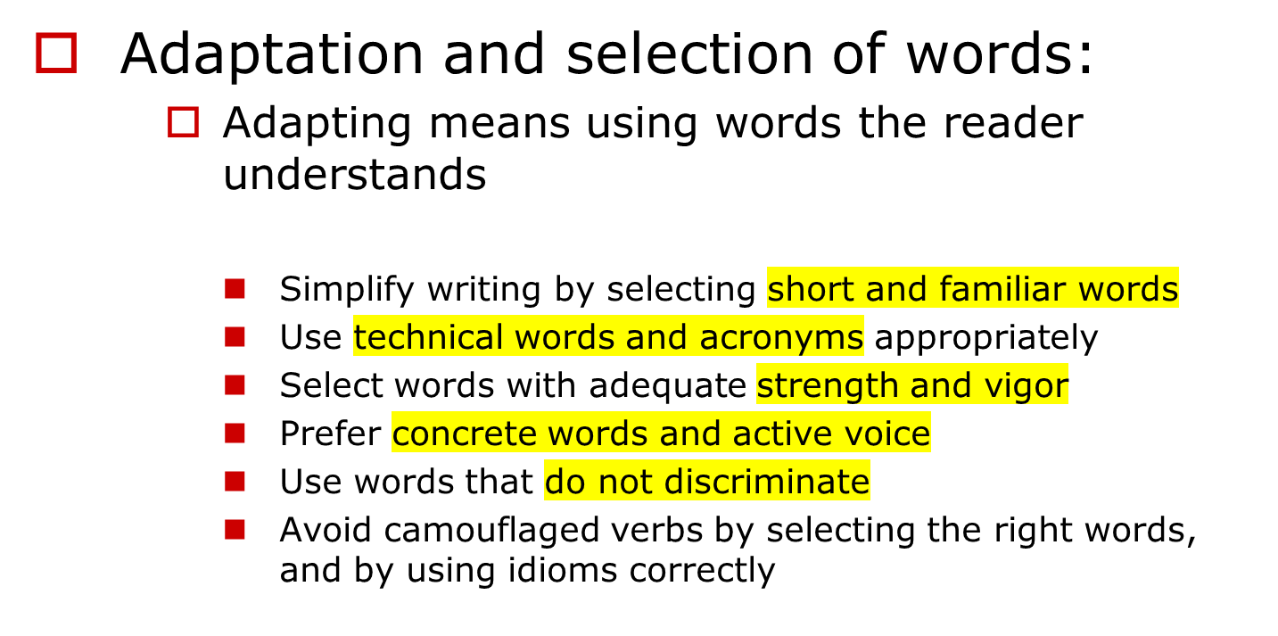
STEP 2: Writing (Contd.)

Slide 15
Prefer the short, familiar word to the long, unfamiliar word.
Long, Unfamiliar Words
Short, Familiar Words
Abbreviate
Accomplish
Ascertain
Shorten
Do
Make sure of

Slide 16
Use Technical Language with Caution.
Social Security’s technical language found to be misunderstood by outsiders:
Technical Language
Improved Version
Survivors’ benefits
Covered employment
Deceased wage earner
To file a claim
Aged workers
Family insurance payments
A job covered by Social Security
Worker who has died
To apply for insurance payments
Workers past 65

Slide 17
Use initials and acronyms with caution.
What do these letters mean?
VCR
FDA
CD
IPO
RV
IRS
Video cassette recorder
Food and Drug Administration
Certificate of Deposit/Compact Disc
Initial Public Offering
Recreational Vehicle
Internal Revenue Service

Slide 18
Consider the strength and vigor of words.
Weaker
Stronger
bonus
disaster
fiasco
lie
destroy
Boost
Bearish market
additional compensation
great loss
complete failure
untruth
put an end to
Upraise
Declining Market

Slide 19
Prefer the concrete to the abstract
Abstract
Concrete
We have found that this technique is successful.
Your department may hire some
new employees.
We will ship your order soon.
Each of the branch managers will receive a substantial pay raise.
This procedure requires a constant low temperature.
Our research shows that 87 percent of those using this technique are successful.
Your department may hire three new stock clerks.
We will ship the Moss No. 41 desk sets you ordered October 12 by Arrow Freight on October 15.
Each of the branch managers will received a 15 percent pay raise.
This process requires a constant temperature of 10 degrees centigrade.

Slide 20
Prefer the active to the passive.
Passive
Active
Your report was read by the president.
The profit and loss statement is prepared by the treasurer each month.
It is suggested that you clean the element in warm, soapy water.
The president read your report.
The treasurer prepares the profit and loss statement each month.
We suggest that you clean the element in warm, soapy water.

Slide 21
Prefer strong verbs to verbs camouflaged as nouns.
Camouflaged Verb
Strong Verb
. . . make a classification . . .
. . . make a computation . . .
. . . conduct an exploration . . .
. . . provide information . . .
. . . engage in negotiation . . .
. . . make an observation . . .
. . . provide representation . . .
. . . classify . . .
. . . compute . . .
. . . explore . . .
. . . inform . . .
. . . negotiate . . .
. . . observe . . .
. . . represent . . .

Slide 22
Prefer strong verbs to verbs camouflaged as nouns.
Camouflaged Verb
Strong Verb
Cancellation of the order was made on the 12th.
Elimination of the deficit was brought about by the change.
The management of this office is conducted by Ms. Brown.
Distribution of the special equipment was accomplished by the safety officer.
We canceled the order on the 12th.
The change eliminated the deficit.
Ms. Brown manages this office.
The safety officer distributed the special equipment.

Slide 23
Suggestions for
Nondiscriminatory Writing
Avoid sexist pronouns by
rewording to eliminate the offending word,
making the reference plural, and
substituting a neutral expression (he or she, he/she, s/he, you, one, person).

Slide 24
Make the reference plural.
Sexist
Nonsexist
If a customer pays promptly, he is placed on our preferred list.
When an unauthorized employee enters the security area, he is subject to dismissal.
A supervisor is not responsible for such losses if he is not negligent.
When a customer needs service, it is her right to ask for it.
If customers pay promptly, they are placed on our preferred list.
When unauthorized employees enter the security area, they are subject to dismissal.
Supervisors are not responsible for such losses if they are not negligent.
When customers need service, they have the right to ask for it.

Slide 25
Substitute a neutral expression.
Sexist
Nonsexist
If a customer pays promptly, he is placed on our preferred list.
When an unauthorized employee enters the security area, he is subject to dismissal.
A supervisor is not responsible for such losses if he is not negligent.
When a customer needs service, it is her right to ask for it.
If a customer pays promptly, he or she is placed on our preferred list
.
When an unauthorized employee enters the security area, he/she is subject to dismissal.
A supervisor is not responsible for such losses if s/he is not negligent.
When service is needed, one has the right to ask for it.

Slide 26
Avoid words with a masculine origin.
Sexist
Nonsexist
man-made
manpower
Congressman
Businessman
Mailman
Policeman
fireman
cameraman
waiter/waitress
manufactured, of human origin
personnel, workers
representative, member of Congress
business executive, businessperson
letter carrier, mail carrier
police officer
fire fighter
camera operator
server

Slide 27
Avoid words that lower one’s status.
Instead of
Use
authoress
actress
poetess
sculptress
male nurse
male secretary
author
actor
poet
sculptor
nurse
secretary

Slide 28
Generally avoid words that stereotype by
Race
  a hard-working African-American
  an honest Sicilian
Age
  golden ager
  youngster
Disability
  deaf and dumb
  crippled
Sexual Orientation
  homosexual
  gay

Slide 29
“Why use two words when one will do.”
--Thomas Jefferson

Slide 30
Construction of Clear Sentences and Paragraphs

Slide 31
Clarity and Short Sentences
Writing clearly generally involves writing short sentences. But there are exceptions.
You can write short sentences in two ways:
  by limiting content (Break up long sentences)
  by using words economically
      Avoid cluttering phrases
      Eliminate surplus word
      Avoid round about ways of saying things
      Avoid unnecessary repetition

Slide 32
1. Break up long sentences.
(Limiting Content)
DON’T
The production planning department assigns to each production order a number that is called a job-order number, which becomes the identifying means of reporting to the accounting department the direct costs relating to a production order, and which can reveal additional information about the job through code numbers or letters added to the job-order number.

Slide 33
1. Break up long sentences.
(Limiting Content)
DO
The production planning department assigns to each production order a number that is called a job-order number. This number becomes the identifying means of reporting to the accounting department the direct costs relating to a production order. Adding code numbers or letters to the job-order number reveals more information about the job.

Slide 34
2. Use Words economically : a. Eliminate cluttering phrases
Regardless of the fact that sales increased, profits continue to decline.
Even though sales increased, profits continue to decline.
In very few instances do the salespeople receive bonuses over the amount of $100.
The salespeople seldom receive bonuses over $100.
At all times the cash box is kept locked.
The cash box is always locked.
In some instances, we sell directly to the retailer.
Sometimes we sell directly to the retailer.

Slide 35
2. Use Words economically :
b. Cut surplus words (words that contribute nothing)
You are hereby instructed to send all daily reports directly to this office as promptly as possible.
Send all reports to this office promptly.
Your attention is directed to paragraph 3, which summarizes the findings of this study.
Paragraph 3 summarizes the findings of this study.
Enclosed herewith are general instructions which are sent to you for your guidance and information.
The enclosed general instructions are for your guidance and information.

Slide 36
2. Use Words economically :
c. Rephrase roundabout constructions
It is our expectation that this plan will be successful.
We expect the plan to succeed.
It is our conclusion that production should stop.
We conclude that production should stop.
Your attention is invited to the contents of enclosed brochures.
Please see the enclosed brochures.

Slide 37
2. Use Words economically : d. Remove unnecessary repetition
This situation calls for quick and expeditious action.
This situation calls for quick action.
This change will enable us to get started sooner than if we wait for a later date.
This change will enable us to get started sooner.
At the present time the research is almost complete.
The research is almost complete.

Slide 38
Sentence Emphasis
Write sentences that give their contents proper emphasis.
Short sentences stand out (an item standing alone gets emphasis).
Long sentences de-emphasize content (the two or more items share emphasis).

Slide 39
Contrasting Pages: Long Paragraphing versus Short Paragraphing
Heavy paragraphs make the writing appear to be dull and difficult.
Short paragraphs give well-organized effect -- invite the reader to read.

Slide 40
Include only necessary information.
Single topic in one paragraph
Connecting words (within and between the paragraphs)
KISS principle
Choose Direct or Indirect order

Slide 41
“Writing and thinking are inseparable.
Not only does thinking help us to write, writing helps us to think.”
--Richard Lederer
The Write Way

